Slide 1
Finance Fundamentals
Helena Pinto

Slide 2
The module leader
The module leader
Dr Helena Pinto
(helena.pinto@York.ac.uk)
CL 123B
Office hours: Fridays 9-11 on Zoom (link on the VLE under: staff communication)
The module tutors
Dr Katie Tseng
Katie.tseng@York.ac.uk
Dr Kiet Duong
(Kiet.Duong@york.ac.uk)

Slide 3
Module aims and objectives
This module provides a solid foundation to concepts in finance and financial markets. It provides an overview of the finance area covering the basic theories of financial markets, corporate finance, and security analysis.
Notes:
3
3

Slide 4
The book
David Hillier; Stephen Ross; Randolph Westerfield; Jeffrey Jaffe and Bradford Jordan (2024), Corporate Finance. Fifth European Edition. McGraw Hill Education.
You will have access to the book through the VLE
You need to register with connect (instructions on VLE; easiest
way go to “week 1” and click on reading assignment
(STUDENT EMAIL)
Every week after the lecture I release the reading assignment which needs to be completed within 2 weeks

Slide 5
House keeping
Lectures and seminars are 2 hour every week.
Seminars start next week attend the seminar in your timetable and attempt the seminar questions in advance
Do your reading assignment every week (using the smart book) and attempt the questions- AFTER the lecture
The reading assignments contribute to your final mark
Notes:
5

Slide 6
Module assessment •Exam in assessment weeks. -Length of examination: 3hours. -Contribution to overall mark: 70%. •Group Assignment -Contribution to overall mark: 30%. You can already enrol (VLE UNDER GROUPS)- MAX 5 MIN 4. Deadline end of week 3- random allocation after

Slide 7
Group assessment •Group Assignment -Contribution to overall mark: 30%. The weekly reading assignments account to 13 marks of your final assignment mark. Students that submit 65% (or more) of the weekly reading assignments are awarded 13 marks in the group coursework; students that submit less than 65% will have the mark adjusted by the proportion of total assignments submitted. there are 9 reading assignments READING ASSIGNMENTS START THIS WEEK

Slide 8
Introduction to Corporate Finance Agency Issues and TMV
Helena Pinto

Slide 9
Organising a business
Sole proprietor
Partnership
Corporation/limited companies

Slide 10
Sole proprietor
Proprietor bears all the costs and keeps all the profits
Advantage: easy to establish; lack of regulations; cheapest business to form.
Disadvantage: unlimited liability; life limited to owners’ life
But Accounting records are needed to be kept for the day-to-day management of the business

Slide 11
Partnership
Partnership agreement defines how management decisions are to be made and the proportion of the profits for each partner
Advantage: still flexible; mainly inexpensive
Disadvantage: unlimited liability; limited life.
Also required to provide appropriate financial information in their tax return for submission to HMRC

Slide 12
Corporation/Limited Companies
Ownership
The shareholders (also known as stockholders or equity-holders) are the owners of the corporation.
Control
Ultimate control rests with the shareholders, but the managers control the day-to-day operations.
Risk Bearing
All parties associated with the corporation bear the risk, but shareholders bear the residual risk

Slide 13
Corporation/Limited Companies
Legal distinct entity from its owners
The legal requirements Companies Act 2006.
Companies House.

Slide 14
Corporation/Limited Companies
Limited companies are required to be registered with Companies House as either a private limited company (Ltd) or a public limited company (plc).

Slide 15
Public Limited Companies (plc)
Corporations commonly start as private limited companies (ltd) of which shares cannot be traded in the public arena- privately and closely held
Shares of plc(s) can be freely sold and traded to the general public and can be listed on a stock exchange but not all plc(s) are traded in exchanges
PLCs are subject to stricter rules.

Slide 16
Corporation/Limited Companies
Advantages
Limited Liability
Permanency
Transferability of Ownership
Better Access to Capital Markets
Disadvantage: time and cost required to manage the legal machinery and tax.

Slide 17
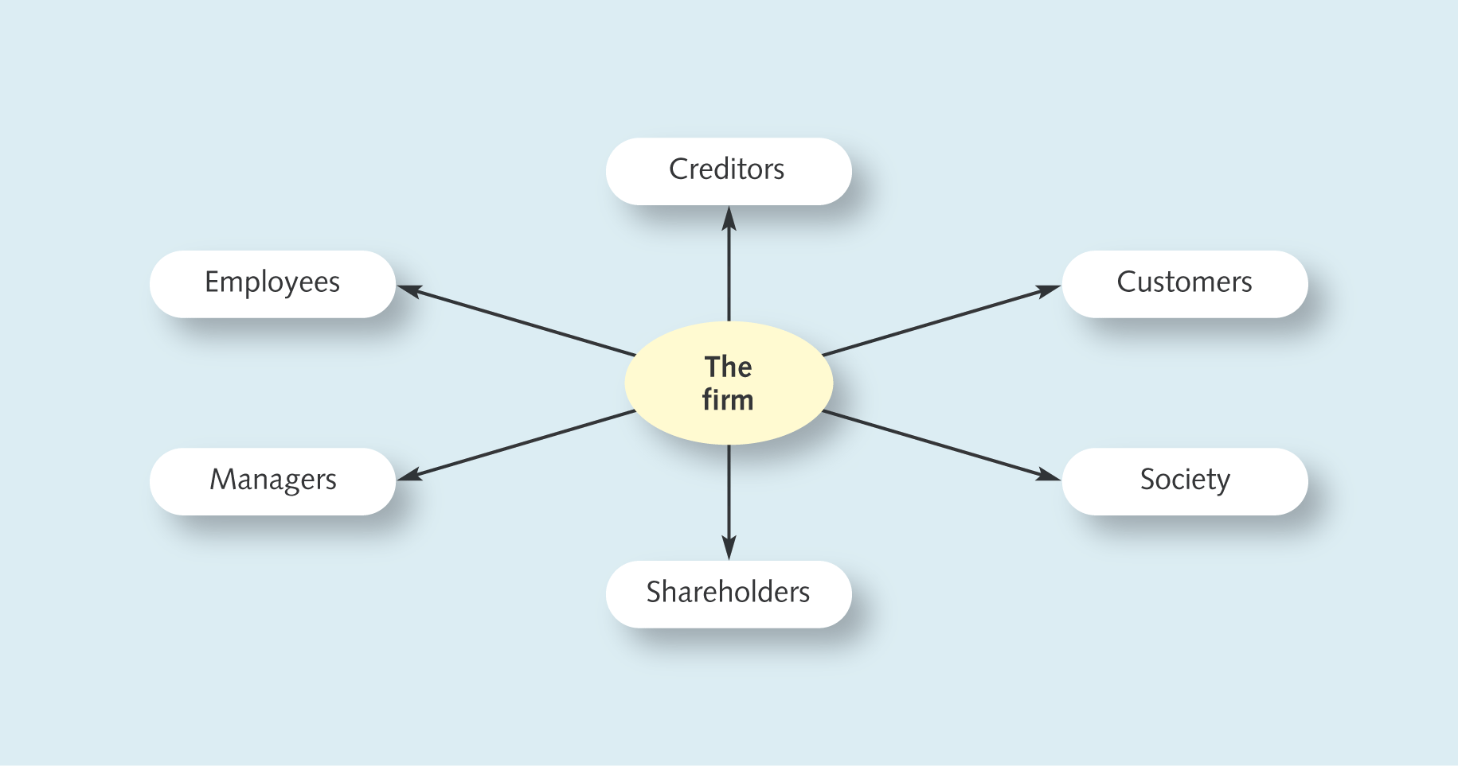
The objective of the firm from a financial management perspective
In whose interests is the firm run? What should the goal be?

Slide 18
Some possible objectives
Increase market share
Keep employee agitation to a minimum
Survival
Maximisation of profit
Profits are not a good proxy of share value
Prospects
Risk
Accounting is subject to judgement
Maximisation of long-term share value
The objective of the firm for Financial Management
Make Investment and Financing decisions leading to the maximisation of long-term share value

Slide 19
Why maximisation of shareholders wealth (share value)
1. From a practical point of view it is easier to focus to have a single objective
2. Contractual theory
3. Free market
4. Shareholders own the firm.
BUT…
Does this ignore other important factors like for example employees; or sustainability objectives?
Triple bottom line (People Profit Planet)?

Slide 20
The main goal
Share value maximisation is a long term objective which is beneficial to all since it will lead to long term firm sustainable growth and value

Slide 21
Role of the financial manager
Firm's
Financial
Financial/Capital
operations
manager
markets
Real assets: assets used to produce goods and services
Tangible
Intangible
Financial assets: Claims to the income generated by the real assets

Slide 22
Role of the financial manager
Financing Decision
How should cash be raised?
Capital structure
Investment or Capital budgeting decision
What real assets should the firm acquire?
Treasury Management
How much cash in liquid form?
Risk Management
Strategy and Value-based management (Financial Objectives)

Slide 23
Who’s the financial manager
Chief Financial Officer
Treasurer
Controller

Slide 24
Principles that form the foundations of Finance
Cash-flow is what matters
Money has a time value- to measure value we bring future benefits and costs to the present

Slide 25
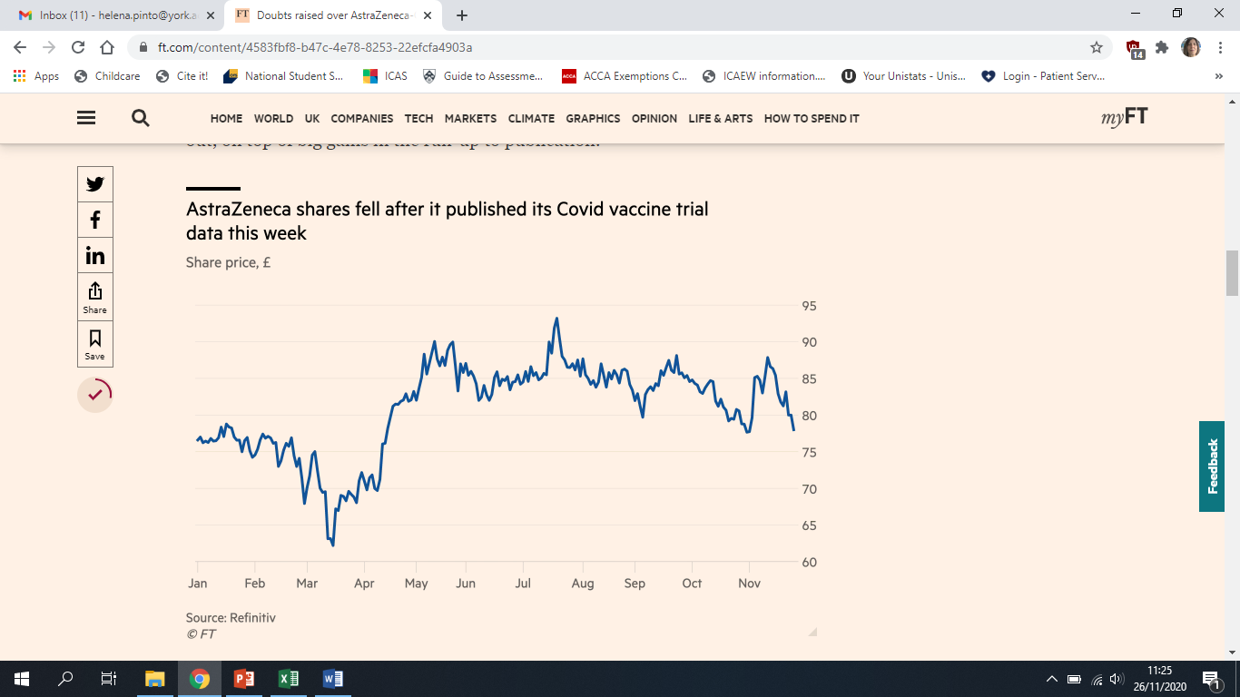
Principles that form the foundations of Finance
Risk requires a reward- investors demand rewards for risk
Market Prices are generally right.
What about Ethics? Ethical lapses are not forgiven in the Finance world. Acting in an ethical manner is morally correct and a fundamental ingredient to long-term success.

Slide 26
Agency issues
In large corporations ownership is dispersed and managers control the firm.
Agency problems may occur when agents (managers) and principals (shareholders) have different objectives.
Agency costs
Agency Theory that describes potential conflicts in the relationship between business principals (shareholders) and their agents (e.g. managers) and proposes solutions for those conflicts

Slide 27
The Agency Problem
Type I Agency Problem
Managers
Shareholders

Slide 28
Agency Costs
Direct costs- occur because of manager extraction of value or to ensure that managers act in the interests of the principals
Expenditure that benefits managers at expense of shareholders
Expenses related to the need to monitor behaviour
Indirect costs- lost opportunities

Slide 29
Managing agency problems
Link rewards to performance
-- Compensation plans
Promotion
Directors sack
-- underperforming managers may be sacked…
Corporate Governance

Slide 30
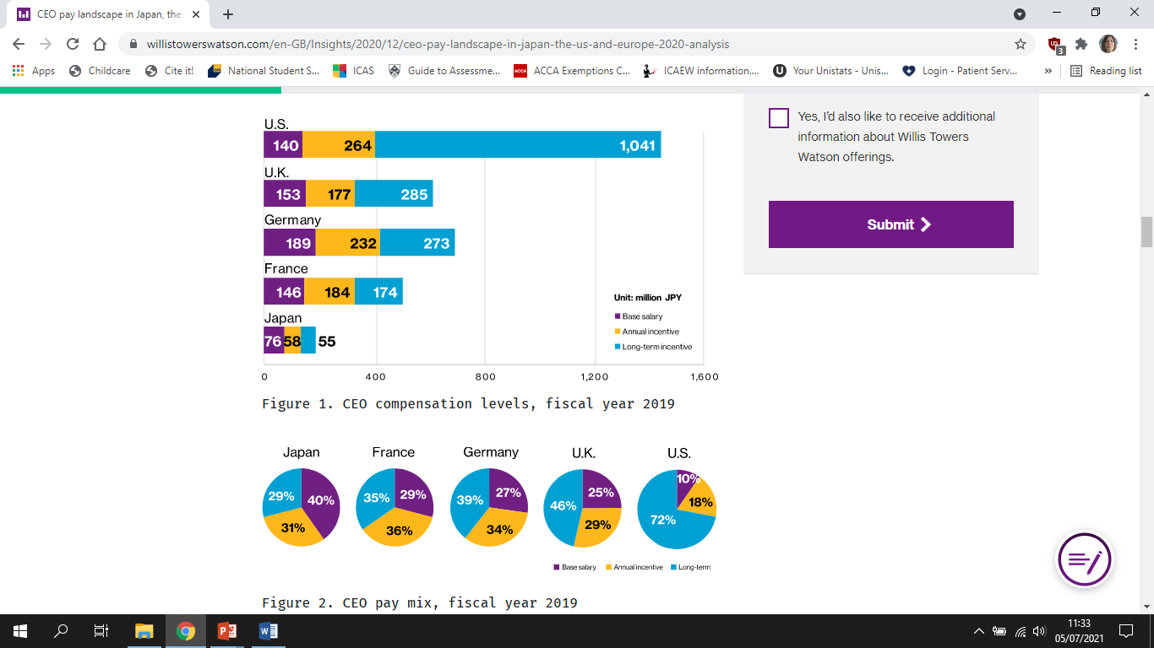

Slide 31
Corporate Governance
The rules and processes by which the behaviour of a firm is directed – used to monitor
Listing requirements LSE
Separate MD/CEO and Chair
Independent boards (significant % of Nes)
Remuneration Committees
Audit Committees (monitors risk management processes)
Nomination Committees
Publication of Financial Statements

Slide 32
The Agency Problem
Type II Agency Problem
Controlling Owners
Minority Shareholders

Slide 33
Example of other agency problems
Agency problems may also occur between other stakeholders and the company.
Stakeholders:
Employees
Suppliers
Governments
Debtholders
etc

Slide 34
Time value of money
Financial decisions require comparison of cash at different dates- for example investors have to decide the price which they should pay today for a promise of cash flows in the future.
1 GBP today is not worth the same as 1 GBP in 20 years time.
Money has a time value.

Slide 35
Future values and compound interest rates
Example-You have £100 in a bank account and banks are currently paying an interest rate of 6% per year on deposits.
What will the interest be in the end of year 1?
What will the value of your investment be at the end of year 1?
What if you leave the money in the bank for 1 more year?

Slide 36

Future values and compound interest rates
Compound interest: interest earned on interest.
Simple interest: interest earned only on the original investment
${(1+r)}^{t }Compound Factor$

Slide 38
Future value sensitivity to interest rate and time

